Slide 1
Semantic Web

Slide 2
Semantic Web is a vision of information that is understandable by computers, so that they can perform more of the tedious works involved in finding, sharing and combining information on the web
Metadata
The first form of semantic data on the Web was metadata :
information about information‖.
<meta name="description" content=“semantic web notes">
<meta name="keywords"content="wikipedia,encyclopedia"> Default charset for plain text is simply set with meta:
<meta http-equiv="Content-Type" content="text/html charset=UTF-8" >

Slide 3
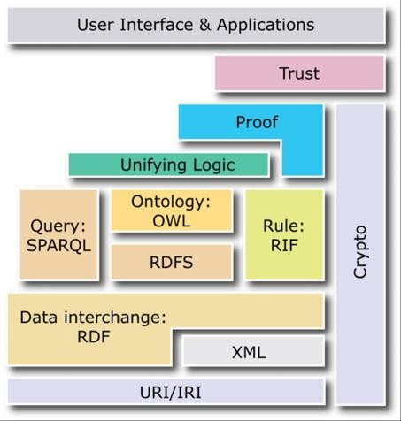
COMPONENTS OF SEMANTIC WEB

Slide 4
Identifiers: Uniform Resource Identifier(URI)
Documents : Extensible Markup Language(XML)
I just got a new pet dog.
<sentence>
<person href="http://aaronsw.com/"> I </person> just got a new pet <animal> dog
</animal>.
</sentence>

Slide 5
<sentence>
<person href="http://aaronsw.com">I</person> just got a new pet<animal type="dog" href="http://aaronsw.com/myDog">dog</animal>.
</sentence>

Slide 6
Statements : Resource Description Framework (RDF)
RDF statement has three parts: a subject, a predicate and an object
<http://aaron.com/>
<http://love.example.org/terms/reallyLikes>
<http://www.w3.org/People/Berners-Lee/Weaving/>

Slide 7
<rdf:RDF xmlns:rdf="http://www.w3.org/1999/02/22-rdf-syntax-ns#" xmlns:dc="http://purl.org/dc/elements/1.1/" xmlns:foaf="http://xmlns.com/0.1/foaf/" >
<rdf:Description rdf:about="">
<dc:creator rdf:parseType="Resource">
<foaf:name>Sean B. Palmer</foaf:name>
</dc:creator>
<dc:title>The Semantic Web: An Introduction</dc:title>
</rdf:Description>
</rdf:RDF>

Slide 8


Slide 9

The simple RDF assertion triple looks like:

Slide 10
Advantage of RDF over XML
- XML is used to provide the strict hierarchy depending upon the requirement and the usage of the users, whereas RDF provides a way to set the loose relations and it has very flexible hierarchy concept. - XML provides an easy control over the content that needs to be used in the XML schemas, whereas RDF uses the seamless technology to integrate the information on the web. - XML is not the ideal process to integrate the heterogeneous information on the web, whereas RDF is being recommended for such operations and methods.

Slide 11
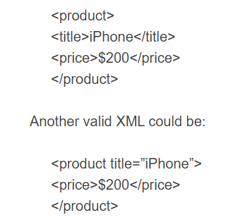
An iPhone is a Product that has a price of $200

Slide 12
Modeling this same data in RDF would only have one way of representing it:
ex:product1 rdf:type ex:Product . ex:product1 ex:title “iPhone” . ex:product1 ex:price “200” .

Slide 13
RDF schema
Fido" is a type of "Dog“
"Dog" is a sub class of animal.
Resource" (rdfs:Resource), the "Class" (rdfs:Class), and the "Property" (rdf:Property).

Slide 14
rdfs:Resource rdf:type rdfs:Class .
rdfs:Class rdf:type rdfs:Class .
rdf:Property rdf:type rdfs:Class .
rdf:type rdf:type rdf:Property .
:Dog rdf:type rdfs:Class .
Fido is a type of Dog":

Slide 15
rdfs:subClassOf and rdfs:subPropertyOf
:Dog rdfs:subClassOf :Animal .
Human rdfs:subClassOf :Animal .
Duck rdfs:subClassOf :Animal .
create new instances of those classes:-
Bob rdf:type :Human .
Quakcy rdf:type :Duck

